Slide 1

Problem Statement and Team Details
Problem Statement:
Team Name:
Team Leader Name:
Institute Name:
Theme Name:
Team Leader Email ID:
To Create an AI-driven OSINT platform for India that gathers, examines, and displays publicly accessible information from social media, news outlets, and public records to support digital investigations while complying with legal and ethical guidelines.
Tech Titans
Satkar Garje
K. K. Wagh Institute Of Engineering Education and Research, Nashik
AI for Social Good / Digital Forensics
satkargarje1@gmail.com

Slide 2
Problem and Solution
Problem: - Manual OSINT (Open-Source Intelligence) investigations are time-consuming and inefficient.
- Lack of structured tools for Indian investigators to analyse public data legally.
- Difficulty in connecting scattered digital footprints of individuals across platforms.
Solution: - Automated Data Collection: Scrapers & APIs to gather public data from Indian sources.
- AI-Powered Analysis: NLP & ML for entity resolution, risk detection, and pattern recognition.
- Ethical Compliance: Built-in checks for Indian IT Act, 2000, and data privacy laws.
- Interactive Dashboard: Visualizes connections, timelines, and risk scores.

Slide 3
Methodology & Implementation
Approach:
1. Data Collection Module
- Sources: Twitter, Facebook, LinkedIn, Indian court records, news sites (via APIs & ethical scraping).
- Tools: Python (BeautifulSoup, Scrapy), Google Custom Search API, Twitter API.
2. Data Processing Engine
- Natural Language Processing (NLP):For sentiment analysis and keyword extraction.
- Machine Learning (ML):
- Entity Resolution: Fuzzy matching for Indian names (e.g., "Mohandas" vs. "M.K. Gandhi").
- Risk Scoring: Identifies suspicious patterns (e.g., fake profiles, hate speech).
- Database: PostgreSQL for structured storage.
3. User Interface (Dashboard)
- Tech Stack: Flask/Django (Backend), React.js (Frontend), D3.js for visualizations.
- Features:
- Search by name/phone/email.
- Network graph of connections.
- Timeline of activities.

Slide 4
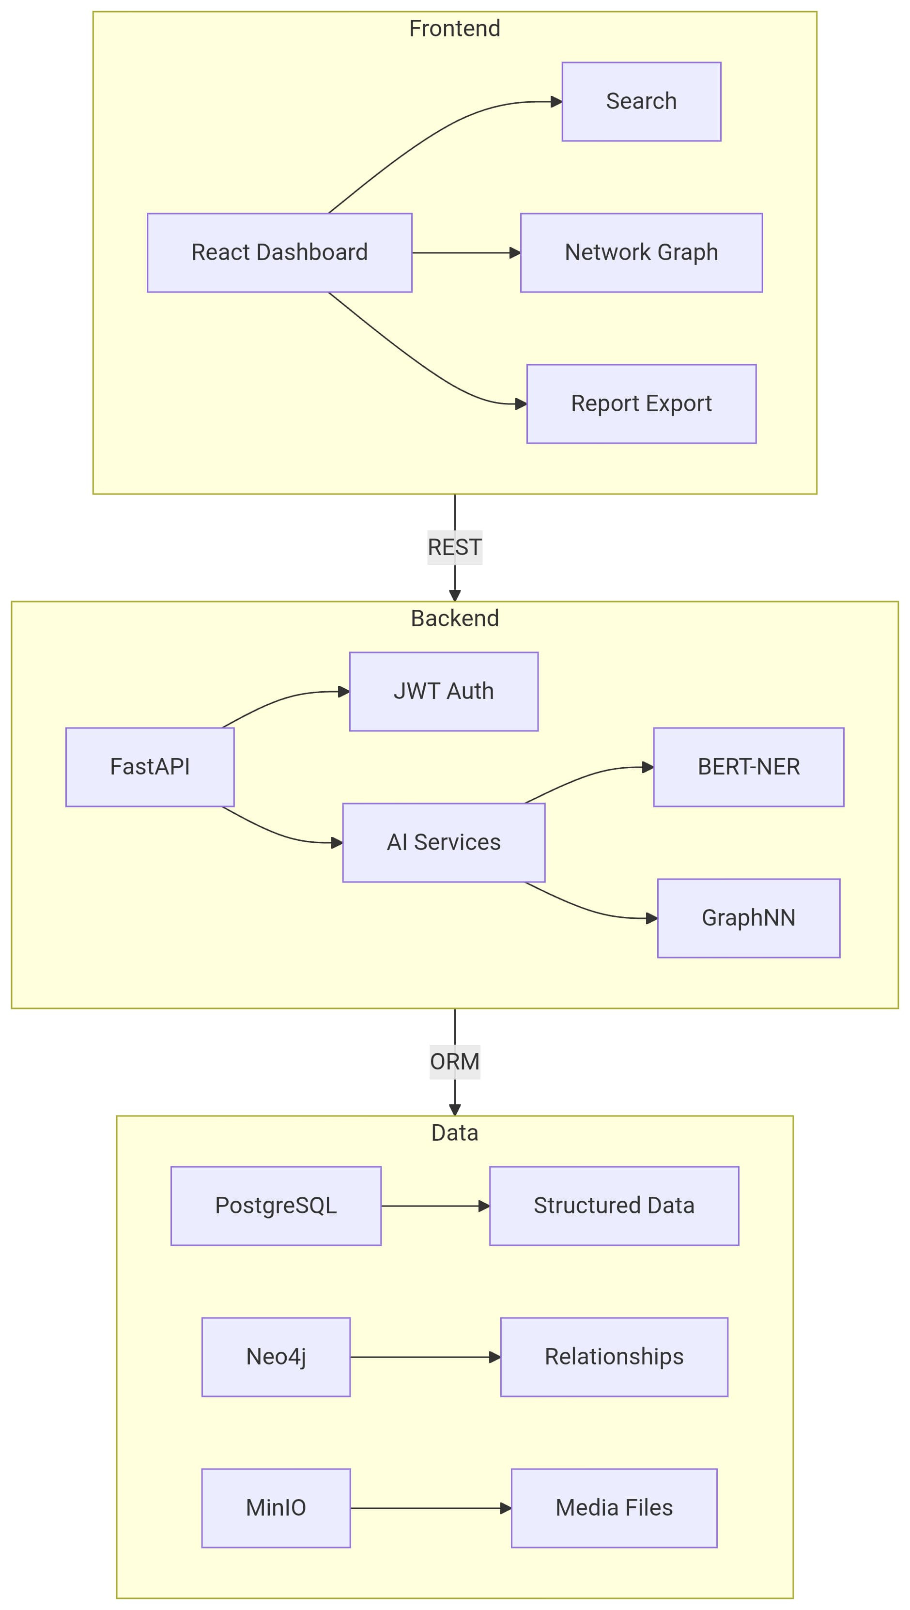
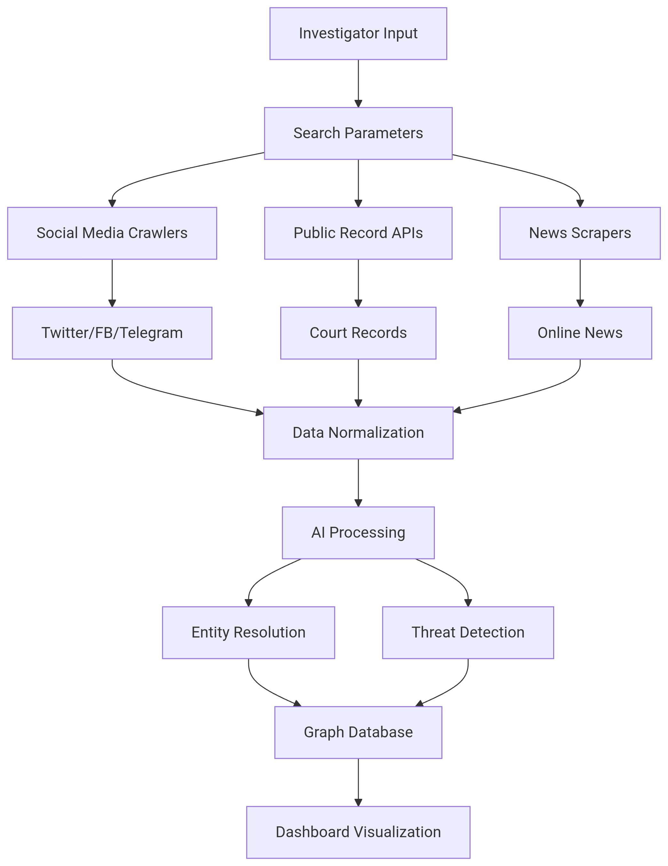
Flowchart & Supporting Images

Slide 5
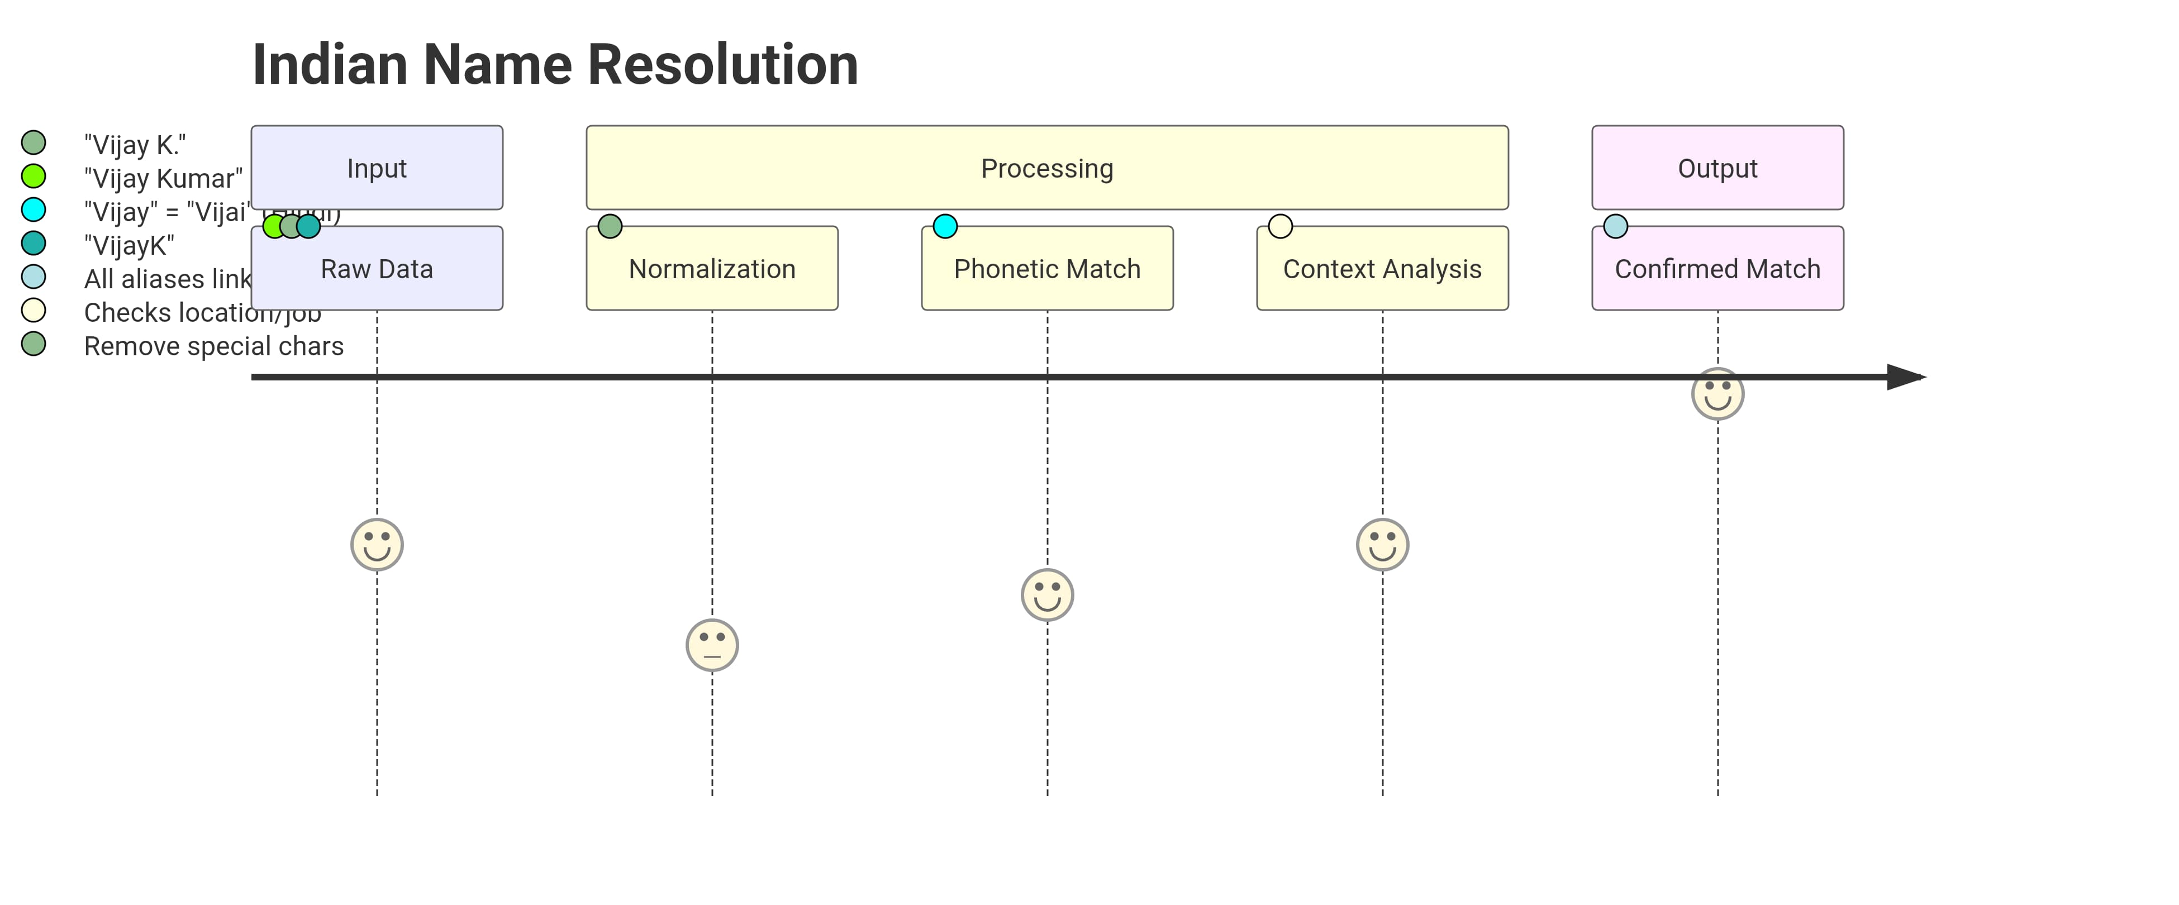
Flowchart & Supporting Images

Slide 6
Feasibility and Market Use
Feasibility:
- Technical: Uses existing APIs, open-source libraries, and scalable cloud deployment (AWS/Azure).
- Legal: Complies with Indian IT Act, 2000, and only accesses publicly available data.
- Economic: Low-cost deployment with Python/JS stack; potential govt./corporate adoption.
Target Users:
- Law Enforcement: Cybercrime units for tracking suspects.
- Corporate Investigators: Background checks on employees/vendors.
- Journalists: Fact-checking and investigative reporting.
Github Link: https://github.com/HrutikAdsare/OSINT.git

Slide 7
Conclusion
Impact:
Saves investigation time by 70%+ with AI automation.
Uniqueness:
First OSINT tool optimized for Indian names, languages, and legal frameworks.
Future Scope:
Integration with UIDAI (Aadhaar) for verified identity resolution (with legal permissions).

